Slide 1
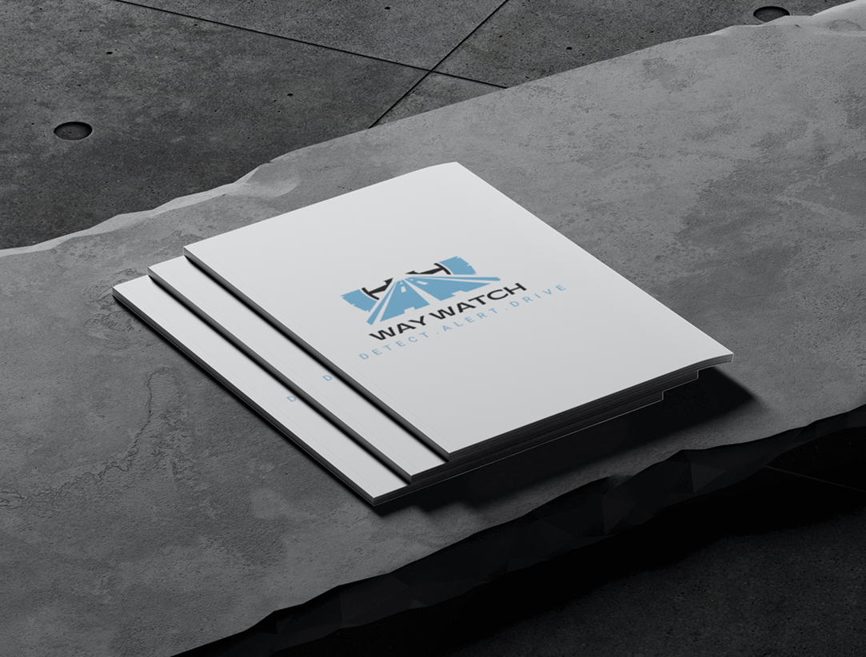
UI DESIGN AND IMPLEMENTATION
Road Sign And Road Map Mobile Notification Application
Task5
Group 5

Slide 2
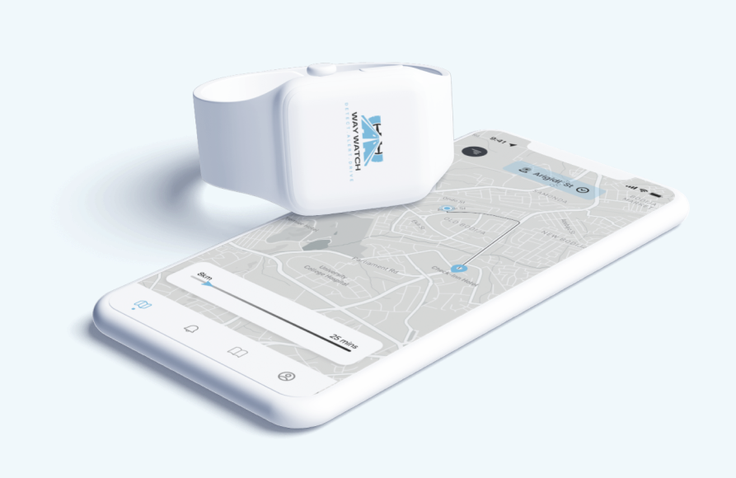
Introduction
WayWatch is a mobile application designed to enhance road safety and driving efficiency by providing users with real-time road sign interpretations, road condition updates, personalized notifications, and integration with navigation systems.

Slide 3
Key Use cases
2
1
Real time road conditions update
Integration with navigation system
3
4
Personalized notifications and alerts
Road Sign Identification and Interpretation

Slide 4
Design Principles
1 Simplicity
3
Consistency
5
Contextual Awareness
2 Intuitive Navigation
4
Responsive Design

Slide 5
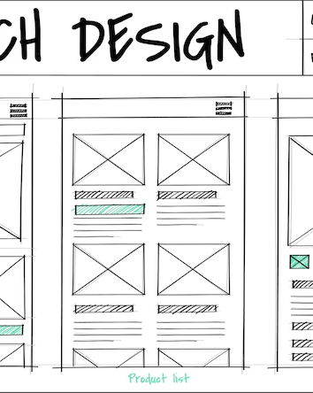
Wireframes wireframes​ Wireframes mockups mockups mockups mockups

Slide 6

Low-Fidelity Wireframes
The Screens here include:
Home Screen
Alert Screen
Learn Screen
User Profile Screen

Slide 7
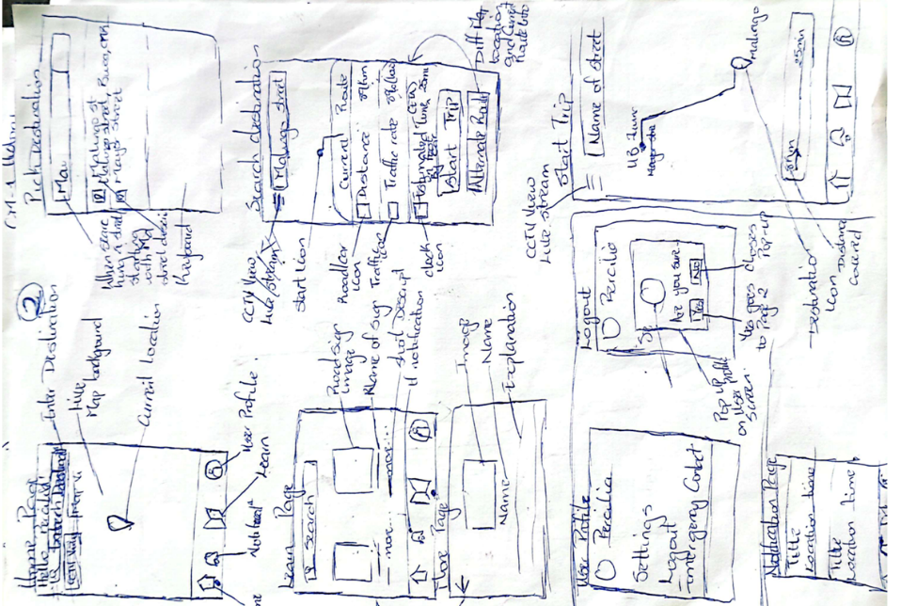
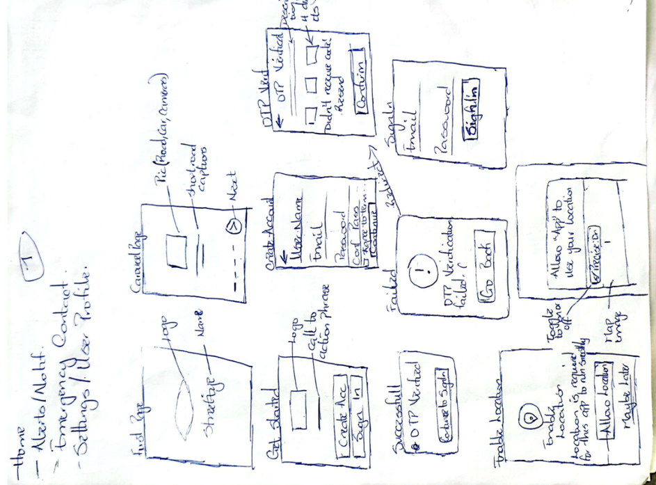
Wireframes(Sketches)

Slide 8

High Fidelity Mockups
Key processes include
Visual Branding : Light Blue (#68B5DE) ,White(#FFFFFF) and Black(#000000)
Typography : Poppins Fonts
Tool Used: Figma

Slide 9
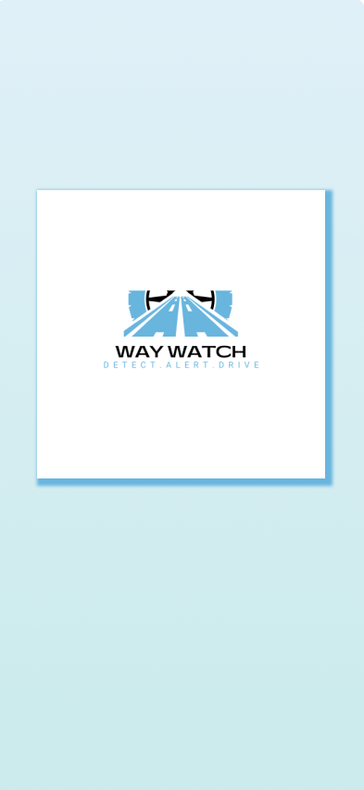
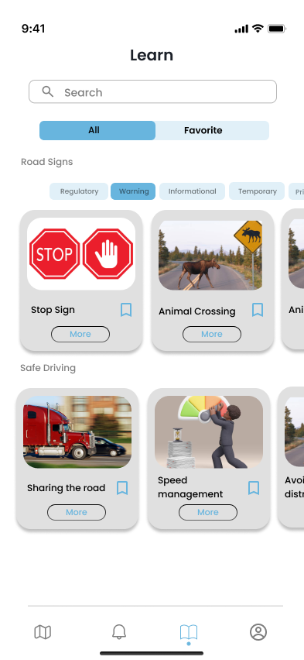
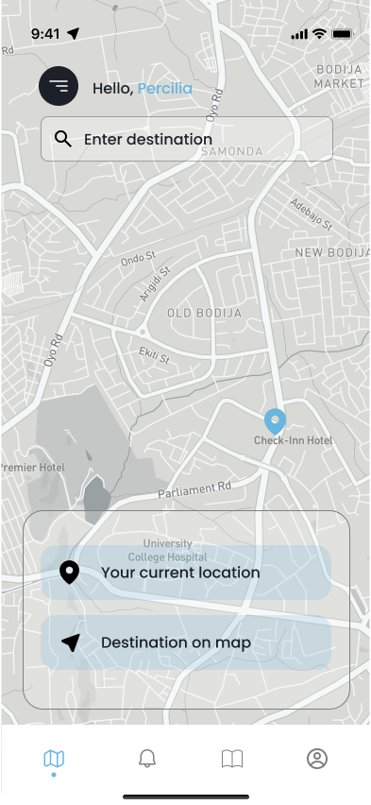
Figma Designs

Slide 10

Front-end front-end front-end implementation implementation implementation implementation

Slide 11
Technical Requirement
1
2
3
4
Cross Platform Compatibility
Responsiveness
Performance
Accessibility

Slide 12
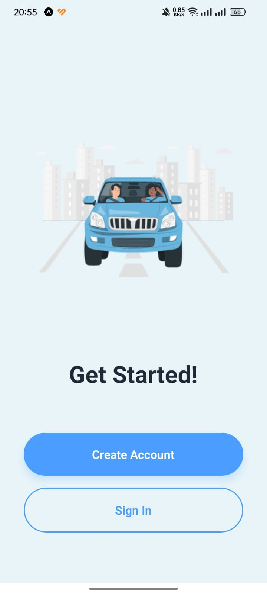
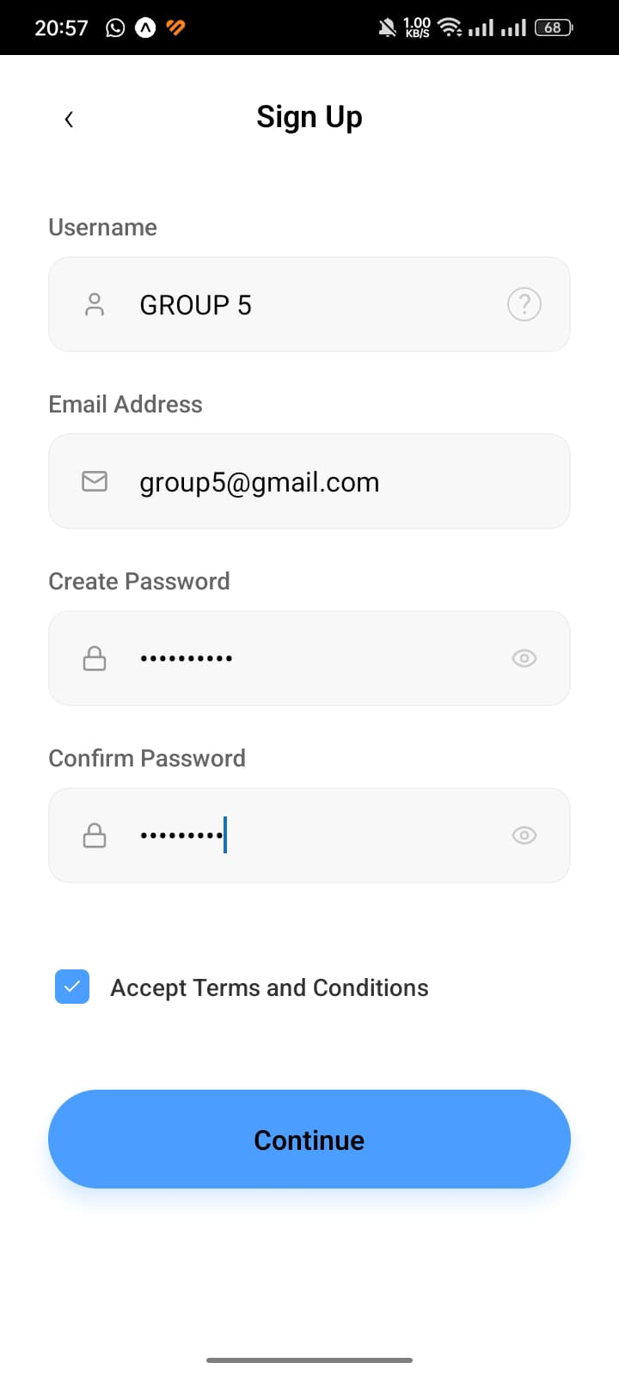
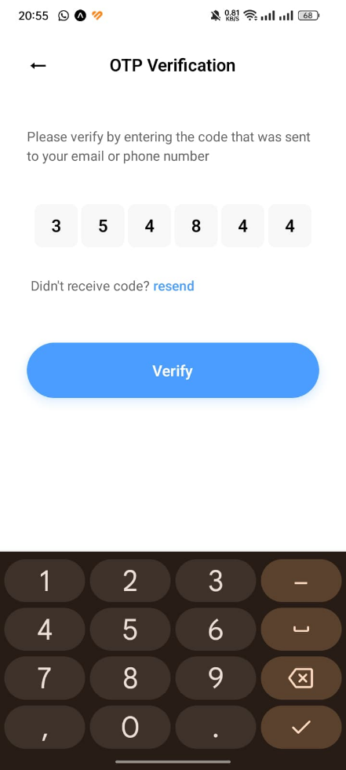
Front-End Implementation

Slide 13
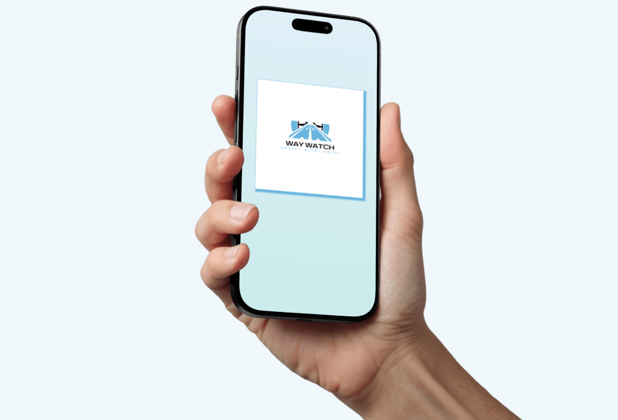
High-fidelity High-fidelity High-fidelity prototype prototype prototype prototype

Slide 14
System Requirements
01
Interactive Features e.g Clickable buttons
02
Realistic UI like fully styled screens
03
User Flow e.g Searching road signs

Slide 15
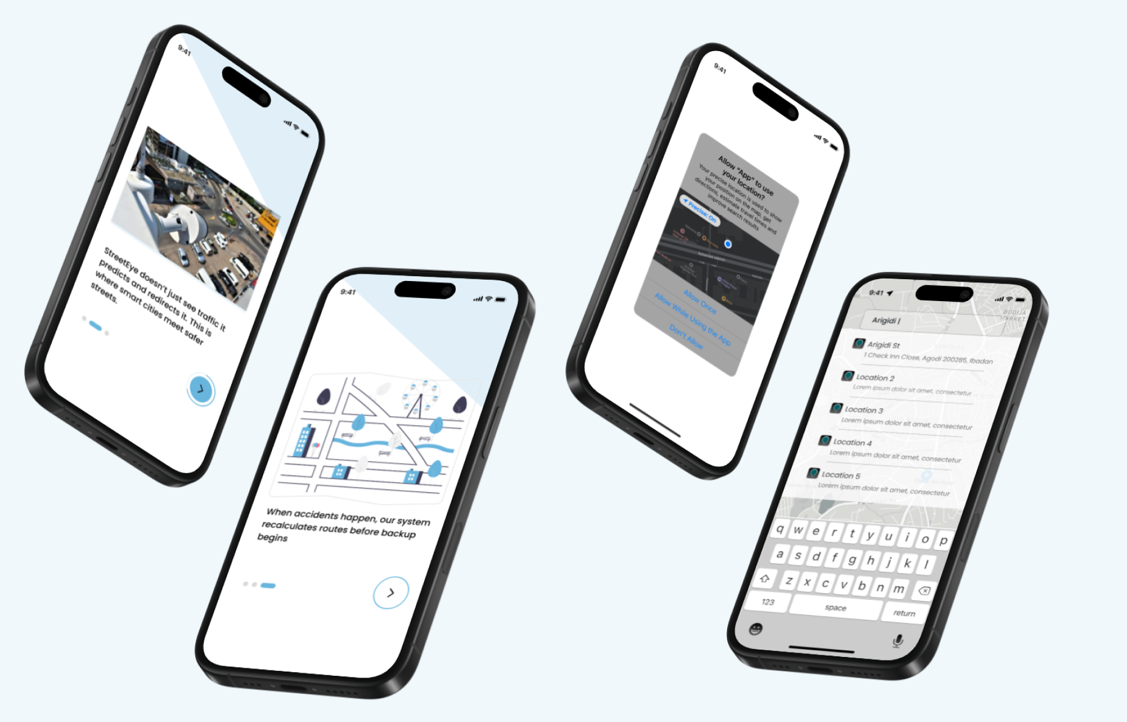
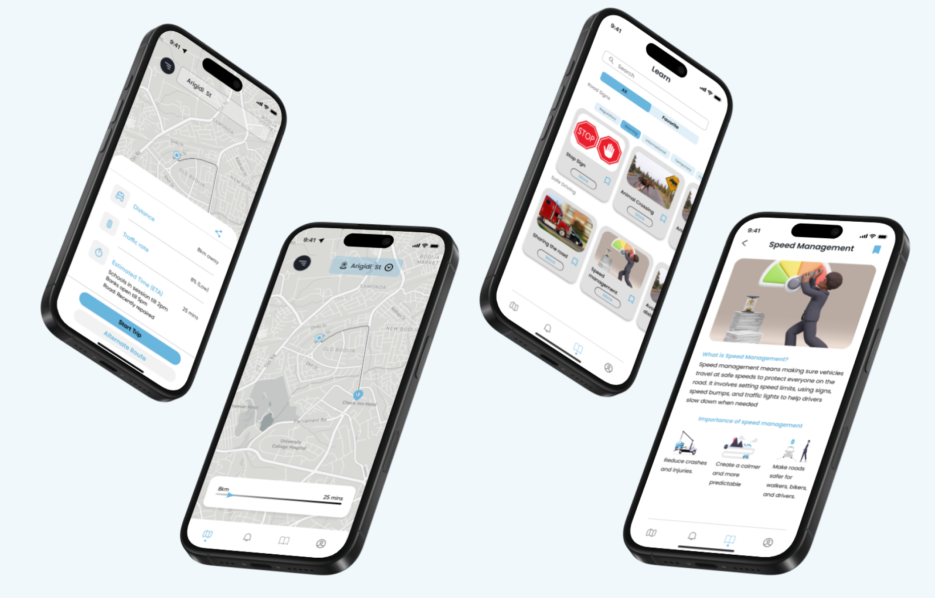

Slide 16
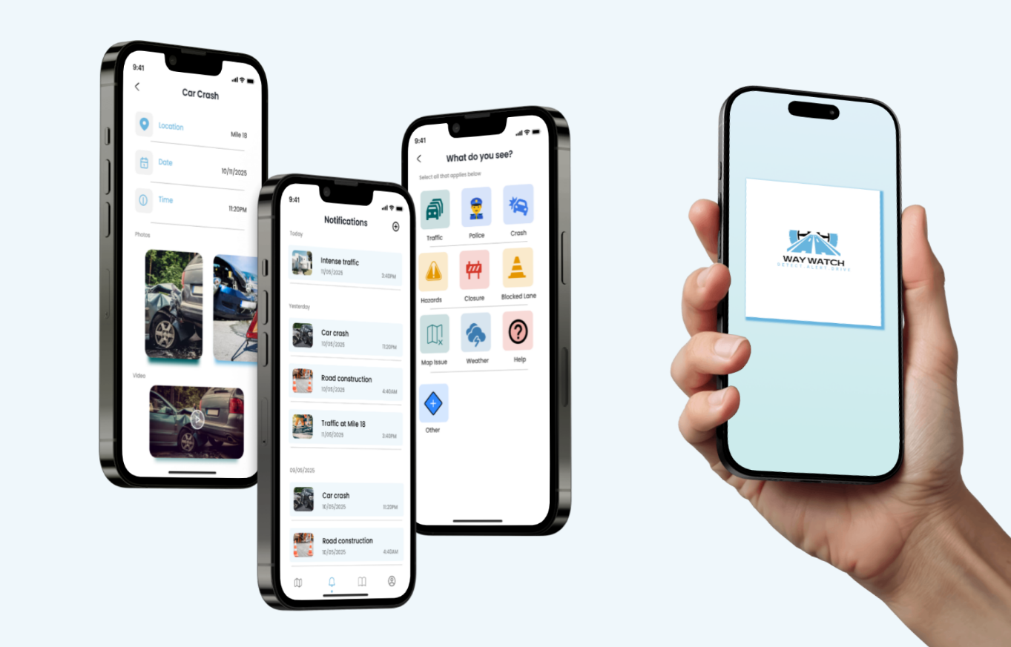

Slide 17

Thank You

